Slide 1
Data Science a Field for the Data Age

Slide 2
Brian Wright Associate Professor Director for Undergrad Programs University of Virginia PhD: Higher Education Administration Economics, Public Policy Founded the DS Program at GWU Founded the DSI at GWU Founded(ing) UVA’s Undergraduate Programs Founder of DS Labs llc Worked in Defense Consulting for 10 years Board Member for DC Data Community – 40k Members

Slide 3
Research Interest: Intersection of Data Science and Education generally

Slide 4

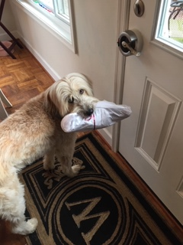
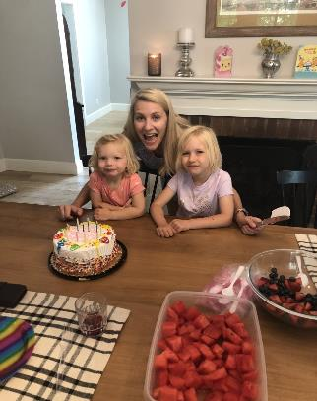

Slide 5
Course Culture

Slide 6
Data as a Societal Level Influence
History/Evolution of Data Science
Defining a Field
Course Overview

Slide 7
Data Age?

Slide 8
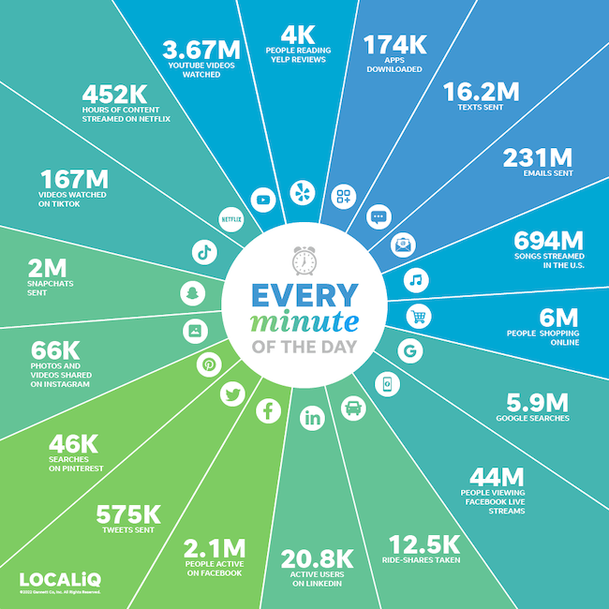
?

Slide 9


What is the time increment?
ⓘ Start presenting to display the poll results on this slide.

Slide 10
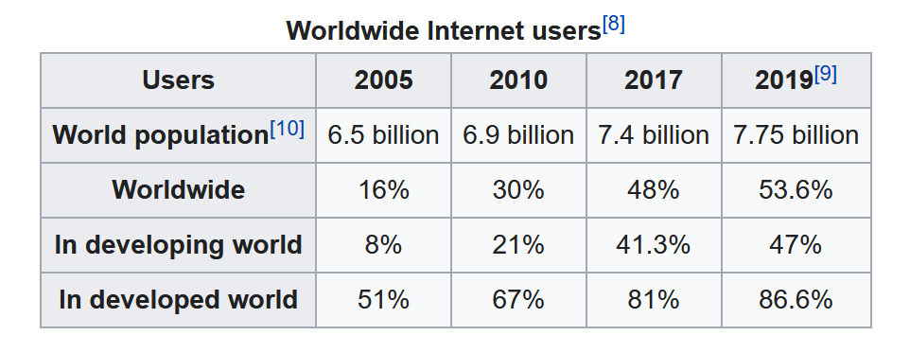
4 Billion social media users
Internet Users Table:
Source: International Telecommunications Union (Agency of the UN)
?

Slide 11
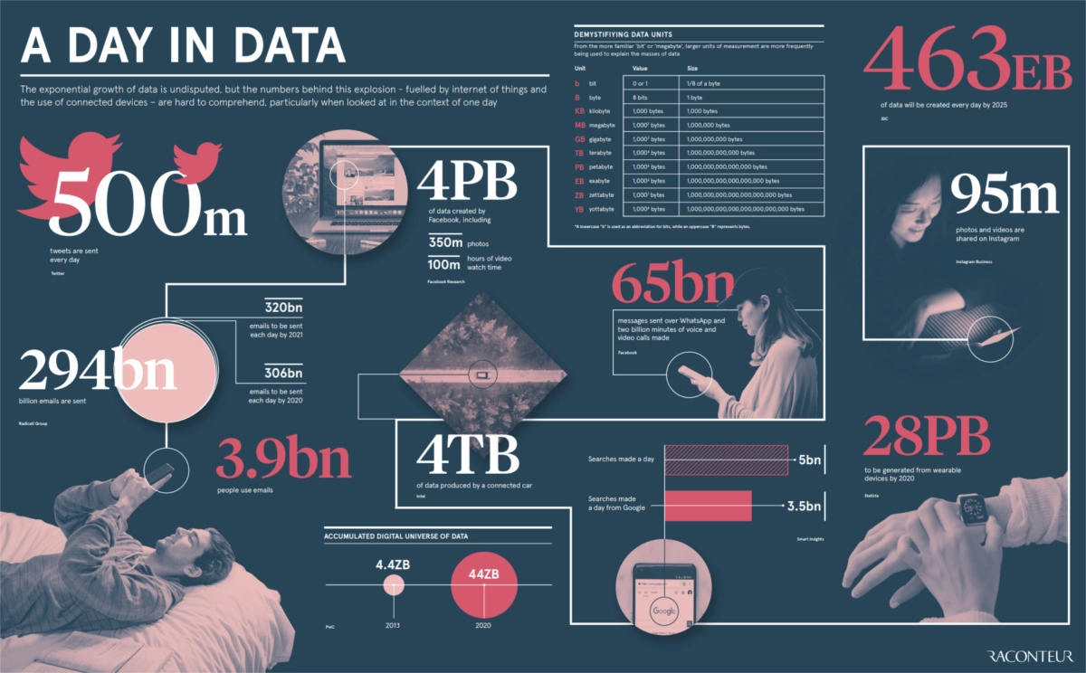
https://www.qwant.com/?client=ext-firefox-sb&t=images&q=normal+distribution&o=0%3A0867C7A9CC1F9B31D9BB2B0D06B41B90CECAFC90
Source: https://www.visualcapitalist.com/how-much-data-is-generated-each-day/

Slide 12
How big is 44zb?
If a kilobyte was the size of a person a zettabyte would be the size of Europe
6.6 stacks of ipads reaching from the earth to the moon

Slide 13
Overview of Data Science Concepts
LAYING THE GROUNDWORK

Slide 14
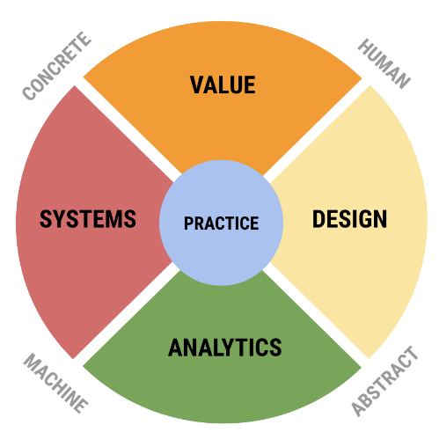
SDS View on Data Science
UVA SDS needed not just pipeline/process but a conceptual model of field.
Rafael Alvarado and myself (& others) created this framework of the field.

Slide 15
“Analytics”
Applied Mathematics
Statistical
Concepts
Artificial Intelligence

Slide 16
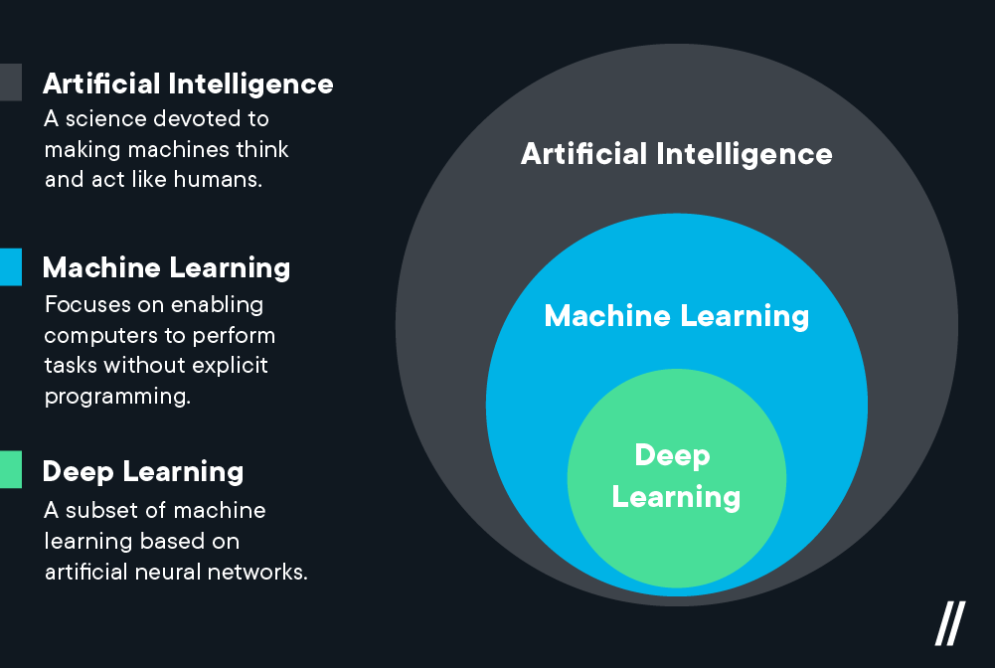
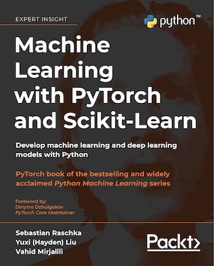

Artificial Intelligence
Flatiron: https://flatironschool.com/blog/deep-learning-vs-machine-learning/

Slide 17
Examples
“Classical AI” – Medical systems designed to warn nurses about prescription interactions
Machine Learning – Amazon product recommendations – uses a boosted tree-based algorithm
Deep Learning – Large Language Models

Slide 18
As you move further into the circle control and explainability decrease but predictive power increases
18

Slide 19
Deep NN
Gradient Boosted Trees
Predictive Power
Random Forest
Decision Trees
Linear Regression
Explainability
19

Slide 20

Notes:
Write in autoregressive transformer off of autoencoders

Slide 21
Machine Learning Key Points
A general-purpose technology or GPT is a term coined to describe a new method of producing and inventing that is important enough to have a protracted aggregate impact.
Similar to electricity or the internet, in that it can be applied across domains and work to improve market outcomes.
Machines/Algo can be trained without the use of explicit instruction, “Learning” part of “Machine Learning”
21

Slide 22
Machine Learning Progress
Error rates on ImageNet (10,000 labelled images) have been driven down from 30% in 2010 to less than 3% today.
Below 5% is important why?
But….
Chess: Deep Blue (IBM AI) searched some 200 million positions per second, Kasparov was searching not more than 5–10 positions probably, per second. Yet he played almost at the same level….why?
Amateur Beats AI Driven Go with Simple Trick
Human Expertise and Experience is still incredibly Important

Slide 23
Machine vs. human
 | Machine | Human
Understanding context |  | ✔
Thinking through the problem |  | ✔
Asking the right questions |  | ✔
Selecting the right tools |  | ✔
Performing calculations quickly | ✔
Performing repetitive tasks | ✔
Following pre-defined rules | ✔
Interpreting results |  | ✔

Slide 24
Example of K-Means, What is Happening?
Given D :{2,4,10,12,3,11,20,25,30}, and k=2 clusters
Randomly assign the means: m1=3, m2=4
K1={2,3}, K2={4,10,12,11,20,25,30}, m1=2.5, m2=16
K1={2,3,4}, K2={10,12,11,20,25,30}, m1=3, m2=18
K1={2,3,4,10}, K2={12,11,20,25,30}, m1=4.75, m2=19.6
K1={2,3,4,10,11,12}, K2={20,25,30}, m1=7, m2=25
K1={2,3,4,10,11,12}, K2={20,25,30}, m1=7, m2=25
Stop, since the clusters and the means found in all subsequent iterations will be the same.

Slide 25
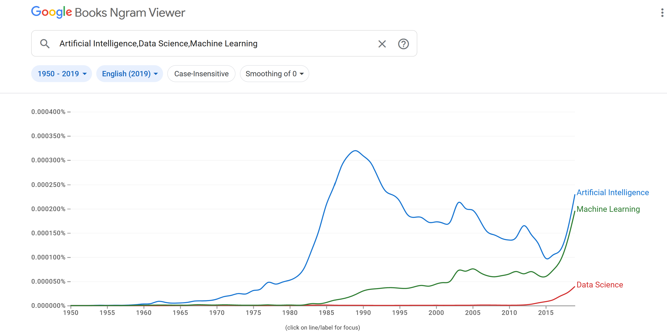

2015, Punctuated Equilibrium:
~90% of the worlds data had been created in last three years
Google (IBM..etc.) sees incredible increases in AI performance
Data workforce increases dramatically
“Big Data” Research is skyrocketing
Housing Bubble
NVIDIA GPU
SPARK Open Sourced/iPhone
See Text Block
?
Notes:
Technology and Macro-economic trends
Punctuated Equilibrium - The theory posits that most social systems exist in an extended period of stasis, which may be punctuated by sudden shifts leading to radical change

Slide 26
2014 | Attention mechanism presented. Bi-directional RNN encoder coupled to a RNN decoder that directly emits a stream of phonemes. | Bahdanau, et al. | Replaces Hidden Markov Models (HMMs) for continuous speech recognition.
2014 | Sequence to sequence learning with neural networks (seq2seq). Uses word embeddings as input data. | Le, et al. | An encoder to read in an input sequence into a hidden state, which is the input to a decoder RNN that predicts the output sequence.
2017 | Transformers invented. New way of representing sequence removes need for RNNs. "Attention is All You Need." | Vaswani (Google) | Introduced positional embedding representation of text that allows for efficient processing of sequential information. Replaces RNNs.
2018 | GPT, the first pretrained Transformer model, used for fine-tuning on various NLP tasks and obtained state-of-the-art results. | Radford, et al. (OpenAI) | Unidirectional.
2018 | BERT announced. | Google | Another large pretrained model, Produces better summaries of sentences. Bidirectional.
2019 | GPT-2. an improved and bigger version of GPT. | OpenAI | Not immediately publicly released due to ethical concerns.

Slide 27
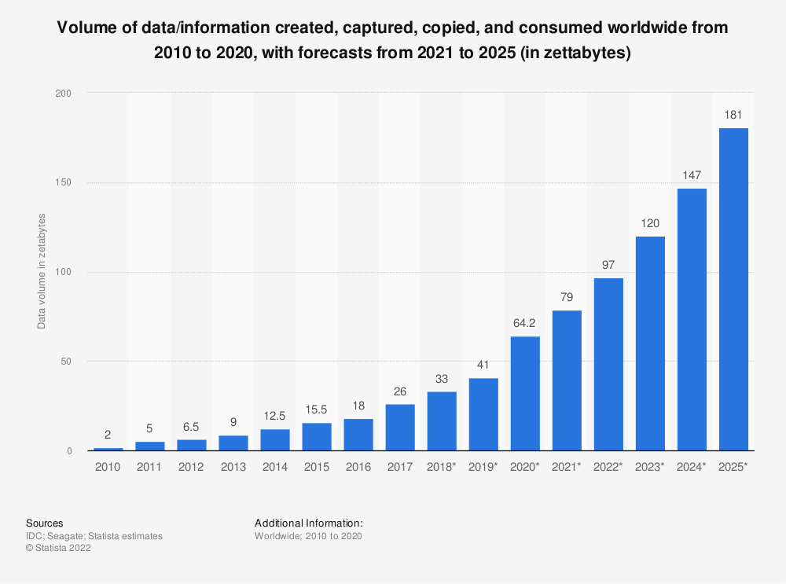
International Data Corporation

Slide 28
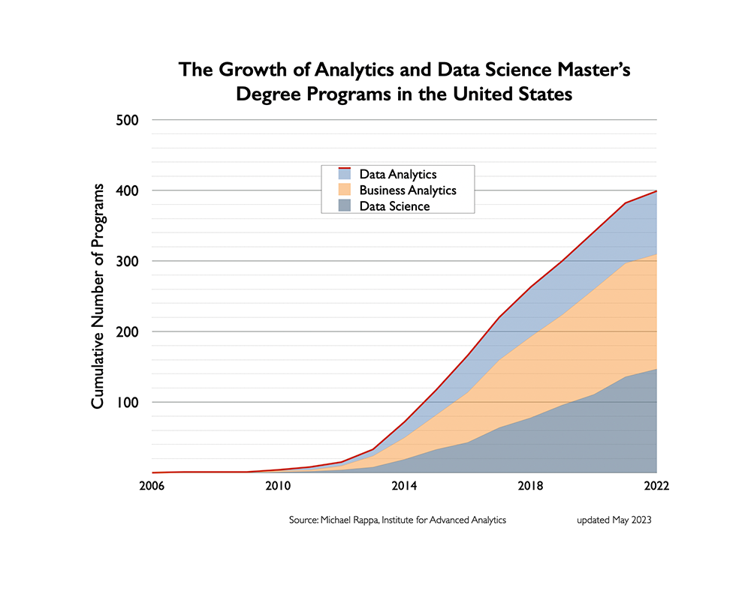

Slide 29
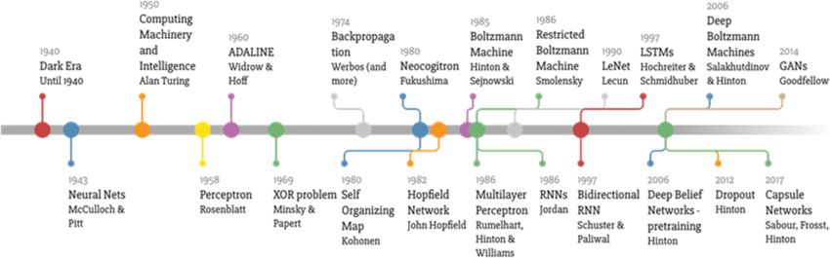
2009 Hal Varian – Google’s Chief Economist – Stats Sexiest Job
DJ Patel and Hammerbacher said to have used the term to define role at Facebook and LinkedIn
2012 Harvard Business Review – Data Scientist Sexiest Job of the 21st Century
Naur/ Tukey – first talk about the field of Data Science
1977 IASC Established
1989 KDD Established
2002/3 Journal of DS and DS Journal Established
Source: Mourtzis, Dimitris & Angelopoulos, John. (2020). An intelligent framework for modelling and simulation of artificial neural networks (ANNs) based on augmented reality. International Journal of Advanced Manufacturing Technology.111. 10.1007/s00170-020-06192-y.

Slide 30
What about the field Data Science?

Slide 31
Data Science, brief History
Series of Academic Pebbles:
1960, Peter Naur used the term “data science” as a substitute for computer science in survey research
John W. Tukey, 1962, “The Future of Data Analysis”:
“For a long time I thought I was a statistician, interested in inferences from the particular to the general. But as I have watched mathematical statistics evolve, I have had cause to wonder and doubt… I have come to feel that my central interest is in data analysis… Data analysis, and the parts of statistics which adhere to it, must…take on the characteristics of science rather than those of mathematics… data analysis is intrinsically an empirical science… How vital and how important… is the rise of the stored-program electronic computer? In many instances the answer may surprise many by being ‘important but not vital,’ although in others there is no doubt but what the computer has been ‘vital.’”

Slide 32
Data Science, brief History
Google Weighs in…
January 2009 Hal Varian, Google’s Chief Economist, says: “I keep saying the sexy job in the next ten years will be statisticians. People think I’m joking, but who would’ve guessed that computer engineers would’ve been the sexy job of the 1990s? The ability to take data—to be able to understand it, to process it, to extract value from it, to visualize it, to communicate it—that’s going to be a hugely important skill in the next decades… Because now we really do have essentially free and ubiquitous data.

Slide 33
Data Science, brief History
Pressure on Academy to change curriculums:
2010 Kirk Borne and other astrophysicists submit to the Astro2010 Decadal Survey a paper titled “The Revolution in Astronomy Education: Data Science for the Masses “
“Training the next generation in the fine art of deriving intelligent understanding from data is needed for the success of sciences, communities, projects, agencies, businesses, and economies. This is true for both specialists (scientists) and non-specialists (everyone else: the public, educators and students, workforce). Non-specialists require information literacy skills as productive members of the 21st century workforce, integrating foundational skills for lifelong learning in a world increasingly dominated by data.”

Slide 34
Data Science, brief History
Data Scientist emerges:
2012 Harvard Business Review article "Data Scientist: The Sexiest Job of the 21st Century“,
DJ Patil claims to have coined this term in 2008 with Jeff Hammerbacher to define their jobs at LinkedIn and Facebook.

Slide 35
Google Ngrams:
2000 and 2019 type in Data Science, Artificial Intelligence
Change the range to 1950
What do you notice?
Add Machine Learning
Add Dataset
Add Internet

Slide 36
Data Science Overview
Much of the emphasis until recently has been on machine learning techniques, driven by:
Increased Access to Computing Power
Larger Training Datasets
Improved Algorithms
Open Access Software
Error rates on ImageNet (10,000 labelled images) have been driven down from 30% in 2010 to less than 3% today.
5% is thought to typically be the human error rate

Slide 37
Ok so lots of data and machine learning/AI but…..
how should the field change…
….more importantly why?

Slide 38
Machine Learning Bias and Social Science Methods
YouTube Case Study
In 2021 YouTube crossed a milestone on hours watched per day….guess?
~1 billion!
Equivalent to ~137,000 years, every day!

Slide 39
Machine Learning Bias and Social Science Methods
YouTube
Around 2011-12 switched their model to hours watched from clicks
Brought in Google Brain to train the Deep Neural Network to make the video recommendations
Similar videos got recommended…but often that resulted in gradually getting more and more extreme content, regardless of the topic and a lack of diversity of topics…jogger to ultra marathon or politically leaning to extremist
Why?

Slide 40
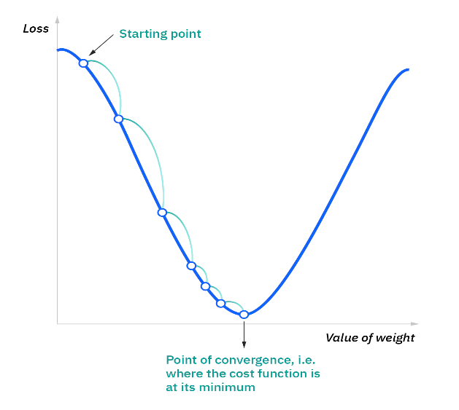
Machine Learning Bias and Social Science Methods
Machine Learning detected the pattern and optimized for it, its that simple.
Also, a perfect feeder system to how our brains interact information…

Slide 41
What else can go wrong….well

Slide 42
Machine Learning Bias and Social Science Methods: Examples
Algos gone bad:
Google’s Cloud Natural Language API was launched in 2016. In fall of 2017 Andrew Thompson from Motherboard Inc. experimented with the tool and discovered bias results.
“I’m Christian” had positive results but, “I’m a Jew” and “I’m a gay black woman” resulted in negative results.
Trained on news and social media data

Slide 43
Machine Learning Bias and Social Science Methods: Examples
From Google: “We dedicate a lot of effort to making sure the NLP API avoids bias, but we don’t always get it right. This is an example of one of those times, and we are sorry.” ☹

Slide 44
Machine Learning Bias and Social Science Methods: Examples
Example:
Amazon Recruiting Engine
Used an AI tool to give candidates a score from one to five stars based on resumes and trained on current successful employees.
“They (Amazon) literally wanted it to be an engine where I’m going to give you 100 resumes, and it will spit out the top five, and we’ll hire those.”
The problem was that data was used from 10 years of hiring that was mostly men, so the ML tool systematically scored women lower
Amazon just this year abandoned the project because it couldn’t be proven reliable.

Slide 45
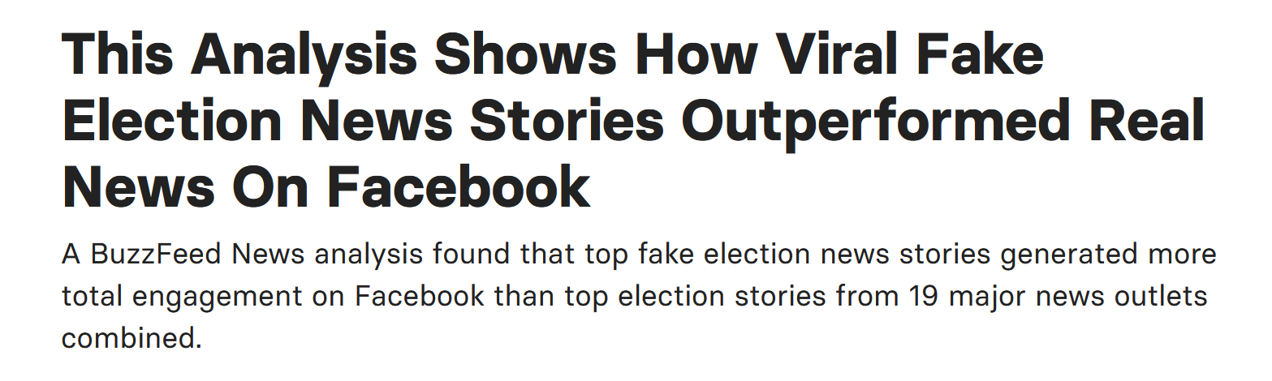
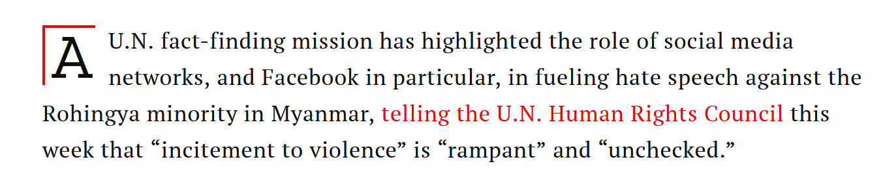
Machine Learning Bias and Social Science Methods: Examples
Facebook
Spread of Fake News
source: https://www.buzzfeednews.com/article/craigsilverman/viral-fake-election-news-outperformed-real-news-on-facebook
Myanmar Genocide
Source: Time.com

Slide 46
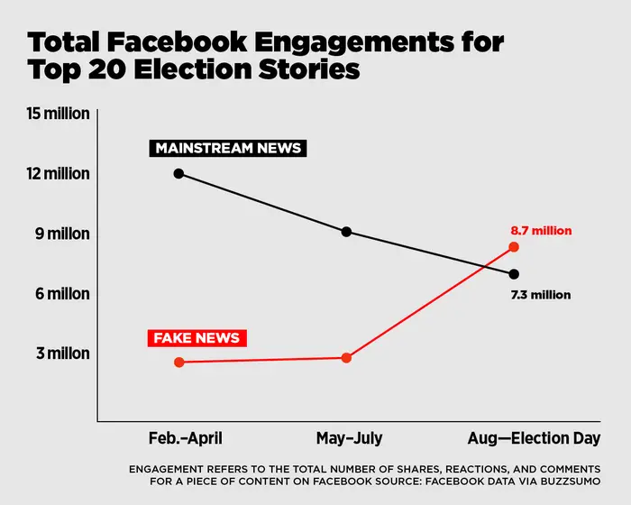

Slide 47
Why?

Slide 48
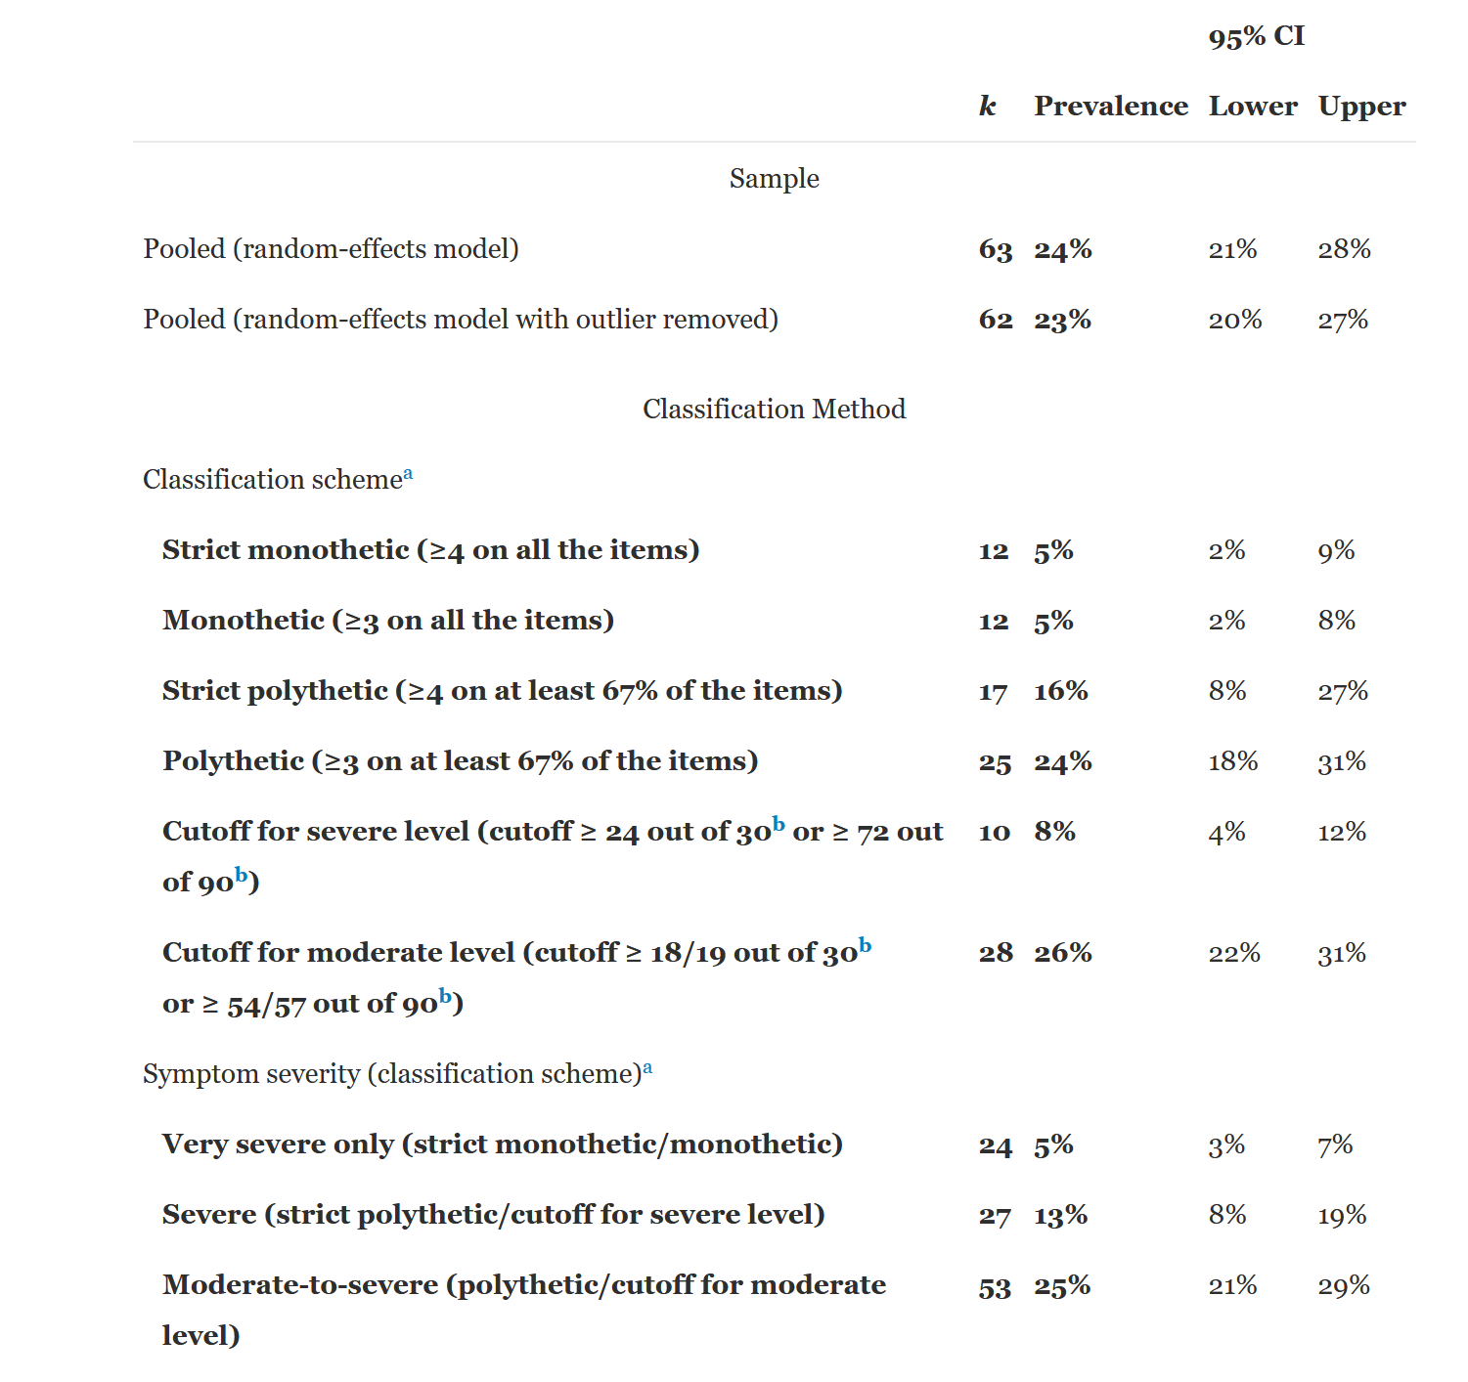
Meta-Analysis
50 Studies
37,798 individuals
Mean age – 24
Gender – 56% Female
July 2020 – 4 Billion user of Social Media
2 billion on Facebook
Very Severe – 200 Million
Severe – 520 Million
Moderate to Severe – 1 billion
Almost half of all social media user could be moderately to severely addicted
Source: Cecilia Cheng, Yan-ching Lau, Linus Chan, Jeremy W. Luk,
Prevalence of social media addiction across 32 nations: Meta-analysis with subgroup analysis of classification schemes and cultural values, Addictive Behaviors, Volume 117, 2021, 106845, ISSN 0306-4603, https://doi.org/10.1016/j.addbeh.2021.106845

Slide 49
"The safety of our authors, viewers, and partners is our top priority.“ Moved to personalized content not promoting broad trends of topics. https://support.google.com/youtube/answer/2801964?hl=en-GB

Slide 50
In Response, the Data Science is Actively Evolving…it is still early days
The field needed a framework…enter the School of Data Science

Slide 51
SDS View on Data Science
“Liberal Arts Degree for the Data Age”
UVA SDS needed not just pipeline/process but a conceptual model of field. Rafael Alavardo created this framework of the field.

Slide 52
Value
Combines the traditional discipline of ethics with the professional activities of business planning, policy making, developing motivations for scientific research, and other activities that have a direct impact on people and the planet.
Key tensions: enterprise vs ethics, private interest vs public good (see Plato’s Republic).
Common theme: human value.
Keywords: ethics, justice, wealth, value, social good, motivation, meaning,
Values: responsibility, diversity, inclusion, flourishing, excellence
Ref: Digital Epidemiology

Slide 53
Gary Marcus: https://www.youtube.com/watch?v=TO0J2Yw7usM
Joy Buolamwimi Facial Recognition

Slide 54
Analytics
Analytics includes what most consider to be the heart of data science, the combination of statistical methods with machine learning, along with optimization, signal processing, network analysis, and other rigorous quantitative methods from a variety of fields.
Key tensions: inference vs prediction, analysis vs simulation.
Common theme: Mathematical models and methods.
Keywords: prediction, inference, machine learning, statistics, operations research, AI, experimental design, causality, optimization, knowledge, models, feature engineering, data mining.
Values: accuracy, precision, validity, truth, convergence, explainability.

Slide 55

https://teachablemachine.withgoogle.com/train
https://beta.openai.com

Slide 56
Design
Human machine interaction as it appears at the points of both consuming data and producing data products. Activities here include the representation and communication of human reality as data for the work of analytics, e.g. in database design, the curation of data, and of complex data and analytical results to humans to drive decision-making and influence behavior.
Key tensions: discovery vs product, user-facing vs analyst-facing.
Common theme: Communication.
Keywords: communication, design thinking, representation, use interface, communication, visualization, visual and object languages, informatics, ontology, curation, HCI, informating, data product design, data discovery.
Values: openness, authenticity, beauty, form and function.

Slide 57

https://labs.openai.com/
“abstract pencil and watercolor of a Data Science Mascot in the form of Andy Warhol”

Slide 58
Systems
Infrastructure systems and architectures to support working with big data — big in terms of volume, velocity, and variety — and building high performance pipelines in both development and production environments. It includes the broad areas of hardware and software (programming) as such — computer technology as opposed to computer science.
Key tensions: development vs production, volume vs speed.
Common theme: building
Keywords: infrastructure, data systems, data engineering, the cloud, networks, hardware, software, programming languages, big data management, benchmarking, continuous integration, availability, cybersecurity.
Values: speed, stability, robustness, resilience, uptime.

Slide 59


Slide 60
Practice
This area consists of actual activities that brings people together to combine expertise from each of the four areas. It is characterized by data science teams working together and with external parties to develop solutions and projects that are responsible, authentic, effective, and efficient.
Working to develop a dozen or more external concentration that students can pursue – examples neuroscience, digital humanities, forecasting and educational analytics.
This is a non-trivial departure from most current undergraduate models.
Research experiences will be provided throughout the 3 years
Develop pathways into applied graduate programs

Slide 61
Course Stuff: Discord Syllabus Python LMI Challenge

Slide 62
Python Help

Slide 63
Python Tutorial: https://www.geeksforgeeks.org/python-programming-language/?ref=lbp Python Data Science Handbook: https://jakevdp.github.io/PythonDataScienceHandbook/ VS Code Documentation: https://code.visualstudio.com/docs

Slide 64
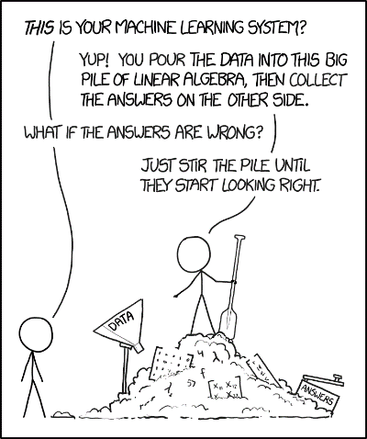
LMI Challenge: https://www.lmi.org/challenge Syllabus/Discord

Slide 65
Dream Job Discussion
See Canvas site

